Slide 1
Testing Web APIs
Frank Walsh
Web Application Development

Slide 2
aGenda
Unit testing
Mocha
Should
Sinon
SuperTest

Slide 3

Testing categories
Static analysis/testing helps to find out typos and basic syntax errors.
Unit testing involves test one single unit at a time with isolation from other functionalities.
Integration testing is where you will find out whether separate units of functionalities works with each other.
End-to-End testing as the name suggests refers to testing the complete flow of the project from start to end.
Notes:
STATIC: A variable with an undefined value
Inconsistent interface between modules and components
Variables that are declared but never used
Unreachable code (or) Dead Code
Programming standards violations
Security vulnerabilities
Syntax violations
UNIT TESTING: individual modules are tested to determine if there are any issues by the developer
INTEGRATION TESTING: The purpose of integration testing is to verify the functional, performance, and reliability between the modules that are integrated.

Slide 4
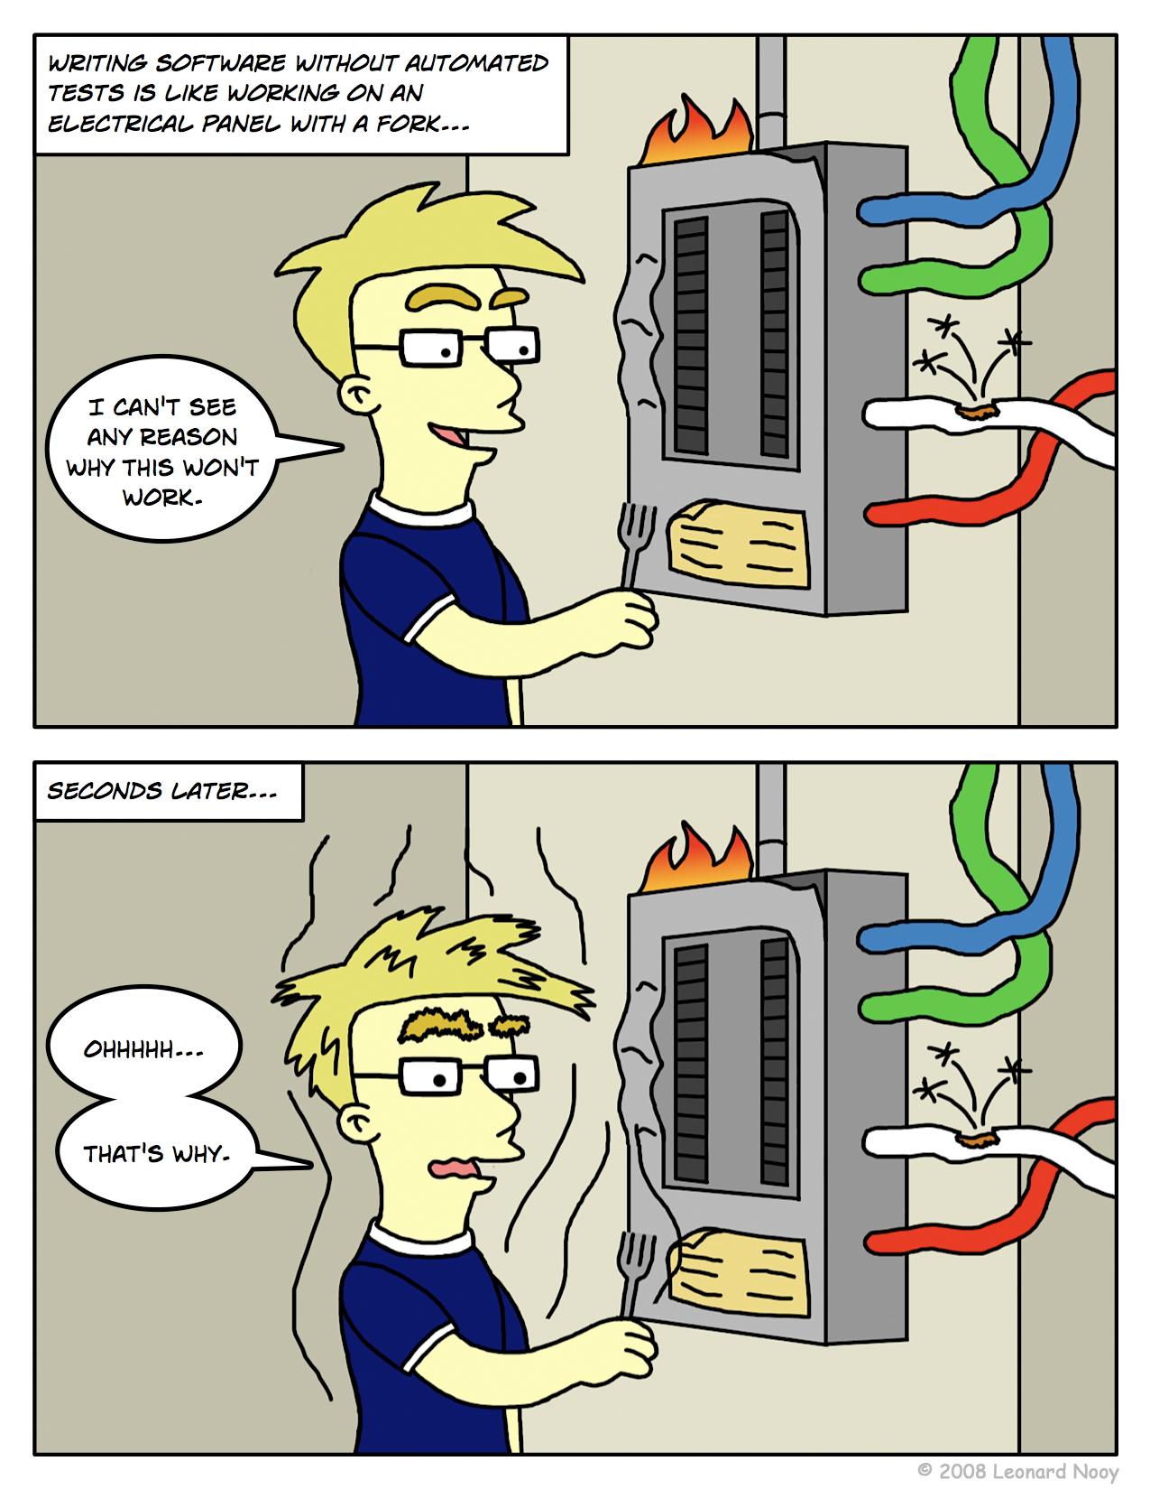
Unit Testing
Code written by developer that exercises a small, specific area of functionality.
“Program testing can be used to show the presence of bugs, but never to show their absence!” – Dijkstra
Up to now – Manual tests with Postman
Not structured
Not repeatable
Not easy
Not a unit test
Usually unit testing is automated…

Slide 5
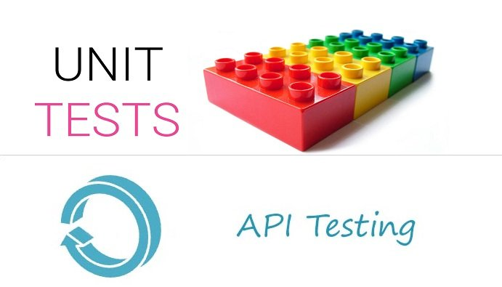
Unit TestS
Tests are specific pieces of code
Tests are written by developers of the code, usually
Sometimes before the code is written
Part of the code repository
They go where the code goes
Use a framework
Junit, Jasmine, Mocha

Slide 6
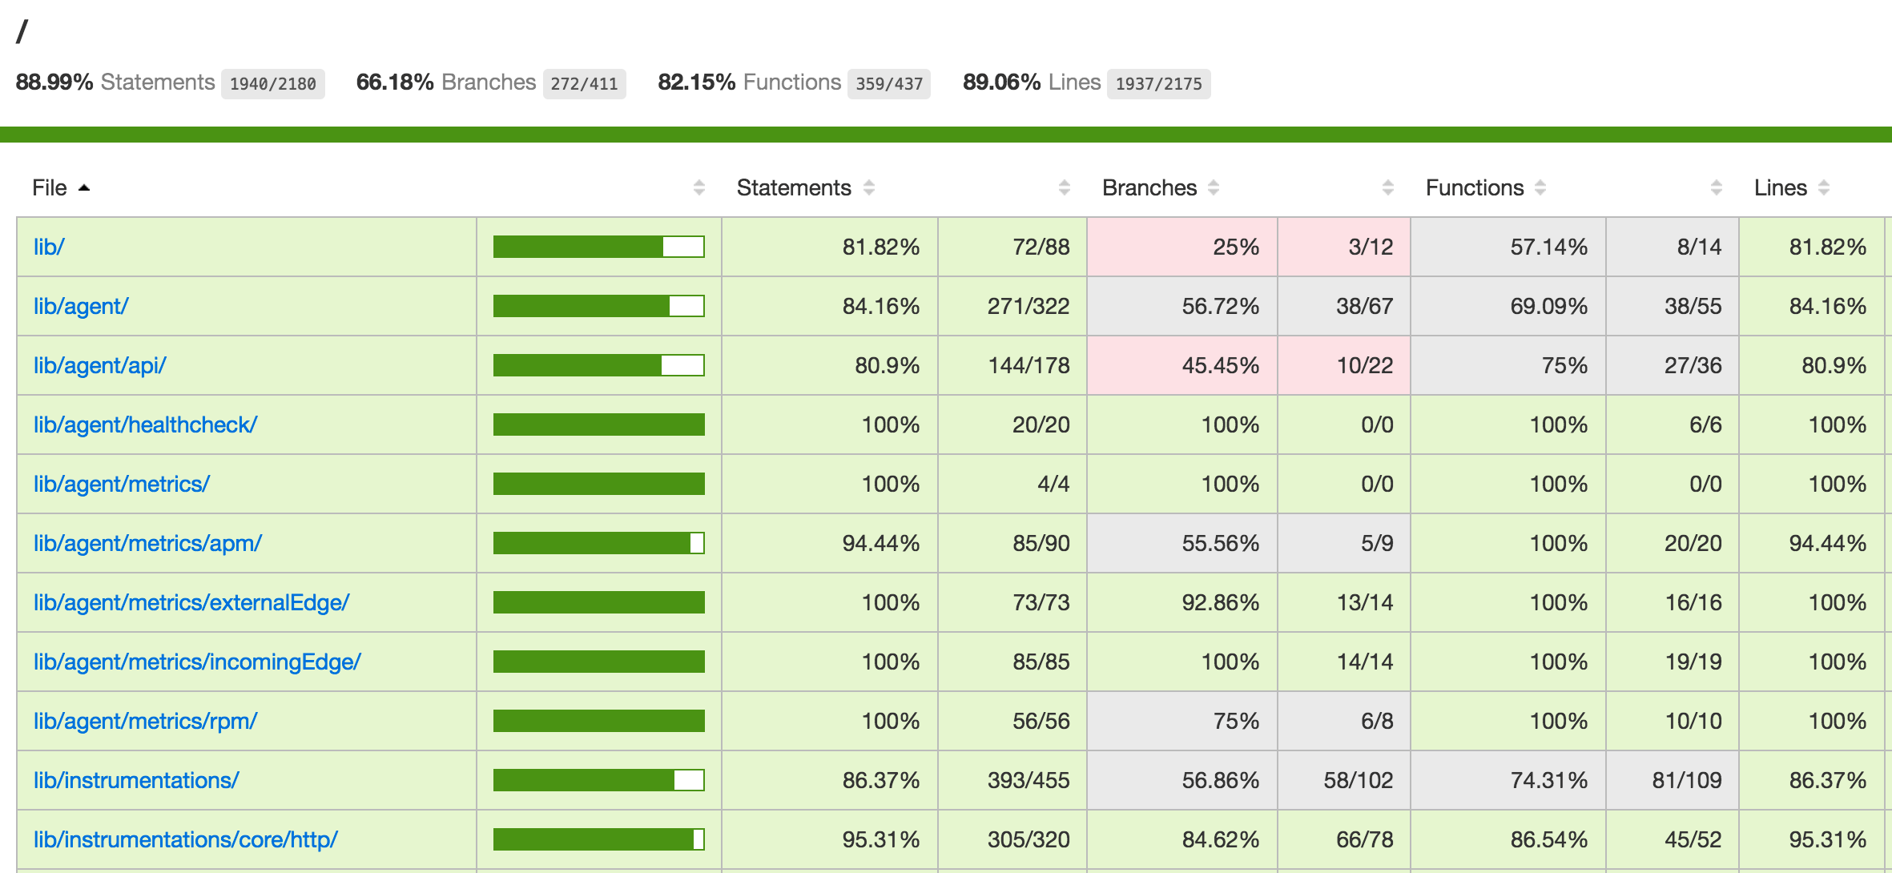
Unit Test convention
All objects and methods
Aspire for 100% coverage
Although property getters/setters are sometimes omitted
All tests should pass before commits to the repo?

Slide 7

Integration Testing
INTEGRATION TESTING combines individual units in a test.
Test drivers and test stubs are used to assist in Integration Testing.
Exposes faults in the interaction between integrated units
Usually happens after unit testing.
Both developers and independent testers perform integration testing

Slide 8
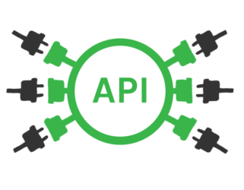
Testing Our API
Is this integration or unit testing?
Integration testing, because you have to run a web server (locally)
Your Web API is an “Application boundary”
Requires HTTP to interact with it
And you’ve a DB/3rd party APIs going
So you’re testing more than just your code…
This Photo by Unknown Author is licensed under CC BY-SA-NC

Slide 9
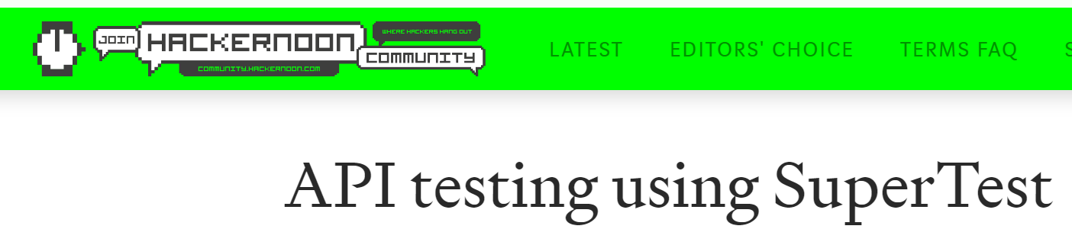

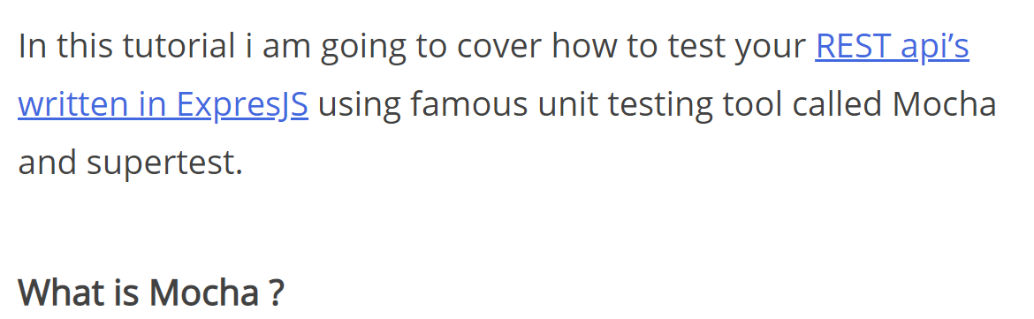

Slide 10
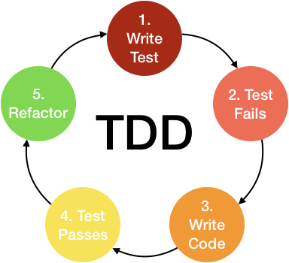
Aside – TDD and BDD
Test Driven Development
assertTheSame(user.name,’tj’)
Behaviour Driven Development
Specify desired behaviour of the unit
Based on requirements set by the business
Behavioural specification from business and developer
user.should.have.property('name', 'tj');

Slide 11
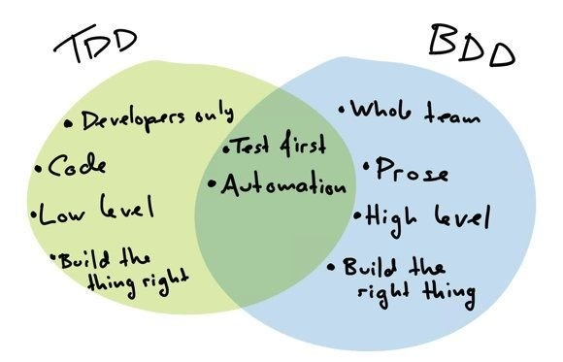

Slide 12
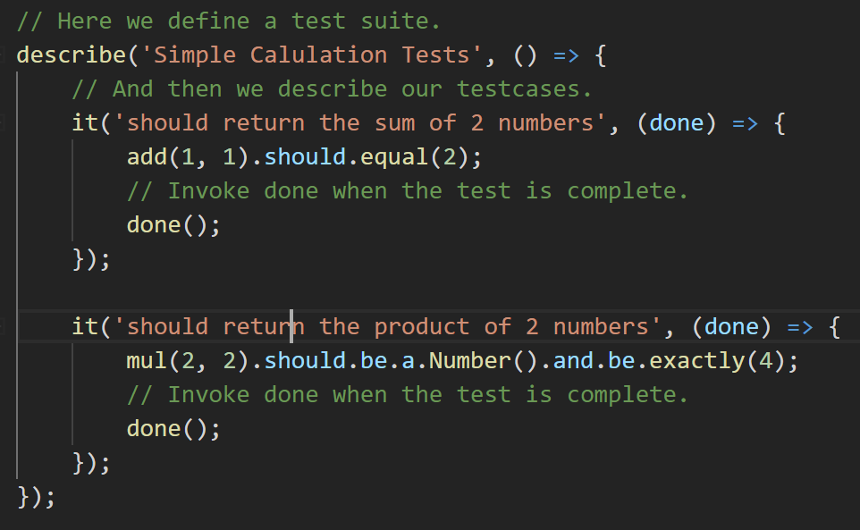
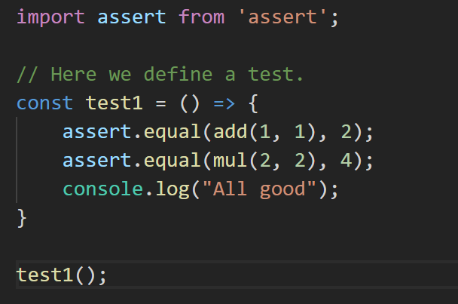
TDD-type test
BDD-type test
“Assert add(1,1) equals 2”
“2*2 should be a number and be exactly 4”

Slide 13
Testing Frameworks, Assertions and mocking

Slide 14

Testing Tools
Test Frameworks
Makes it easier to write tests
Provide hooks, test suites, test runners
Examples Junit, VS Team Test, PHP Unit, Mocha
Assertion Frameworks
Perform checks and decisions
Examples: assert, chai.js, should.js
Mocking Frameworks
Create mock dependencies, stubs, proxys
Sinon, Jmock, Mockito, Mockgoose!

Slide 15
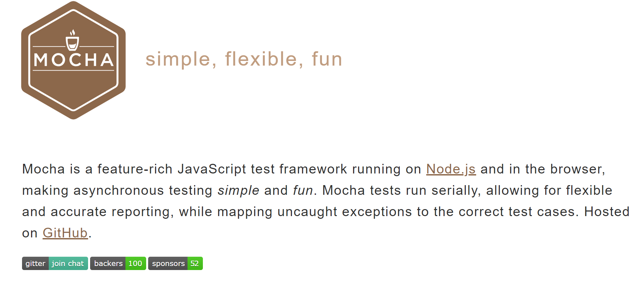
Test Framework

Slide 16

Test Framework
Open Source framework for Javascript unit testing
Run in browser and server-side (e.g. node)
Features
Expressive syntax
Can test Async code
Pluggable
Compatible with test runners such as Karma

Slide 17
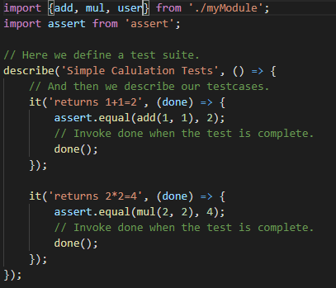
Assertion Framework
Can use the “assert” package
Node.js core package
Define a Test Suite
In the test suit, create test cases
Invoke “done()” when each test is complete.
Not very expressive or high functioning
Better 3rd party options: chai, should…

Slide 18
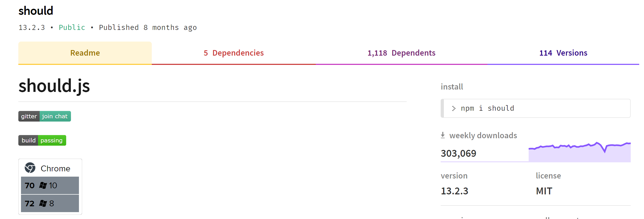
Assertion Frameworks

Slide 19
Assertion Framework
Mocha allows you to use any assertion library you wish.
should is an expressive, readable, framework-agnostic assertion library.
Can use with Mocha to write cleaner, more BDD style tests
Generates nice error messages (there’s always error messages!)
Works with Node and browsers
Can use in asyc tests with Mocha

Slide 20
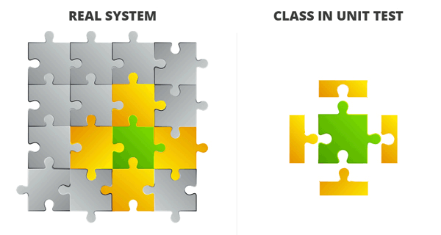
Mocking Framework
What if your code has methods that use/integrate a DB?
What if your code uses an API that’s not ready
Can use mocking and stubs to override/replace/mutate aspects of the code to allow you to test various scenarios in an isolated fashon
Examples: Proxyquire, Sinon

Slide 21
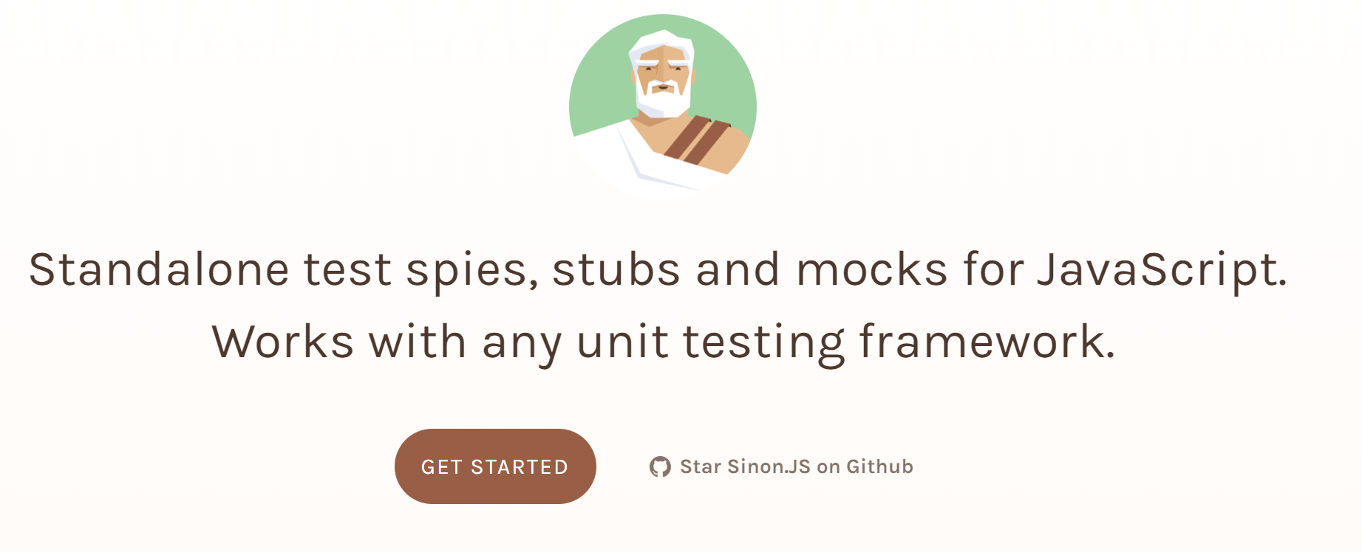
Sinon Mocking Framework
Can use sinon to create “stub” that can respond with fake data
Allows isolation of target code.
Why you might need this?
a js module may have public functions that need to be tested. Functions can make a call out to another service or to a database.
E.g. User Mongoose model…

Slide 22

How it works…
Provide description of test using “describe”
Use “it” to define several test cases into it.
“it” provides a “done” function, used to indicate the end of test case.

Slide 23
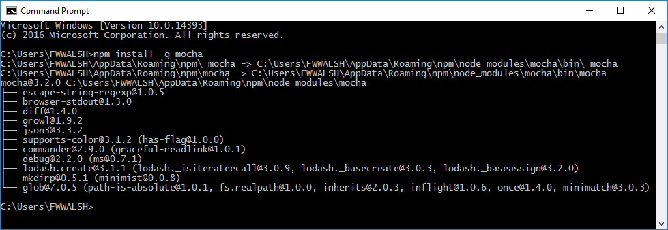
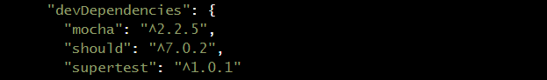
Getting Mocha etc.
Use NPM and install Mocha, Should and Supertest
npm install --save-dev mocha
npm install --save-dev should
npm install --save-dev sinon sinon-test
npm install --save-dev supertest

Slide 24
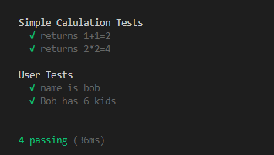
Running the test Manually
From command prompt, type
npx mocha
As we’re ES6 and need to transpile, easier to create a script entry in package.json
Can associate tests with node project by including new script property
Set up a test script in package.json
Then use npm run test at the command line

Slide 25
EXAMPLE….

Slide 26
Testing an API (integration testing)

Slide 27
API Tests
Testing with postman not ideal
Cannot formally specify test suites
Cannot integrate into testing
Fine for development cycle
Need a more structured method of testing APIs
Regression (all routes should be checked before commit)
Use HTTP requests to test express app

Slide 28
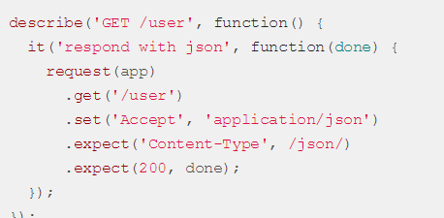
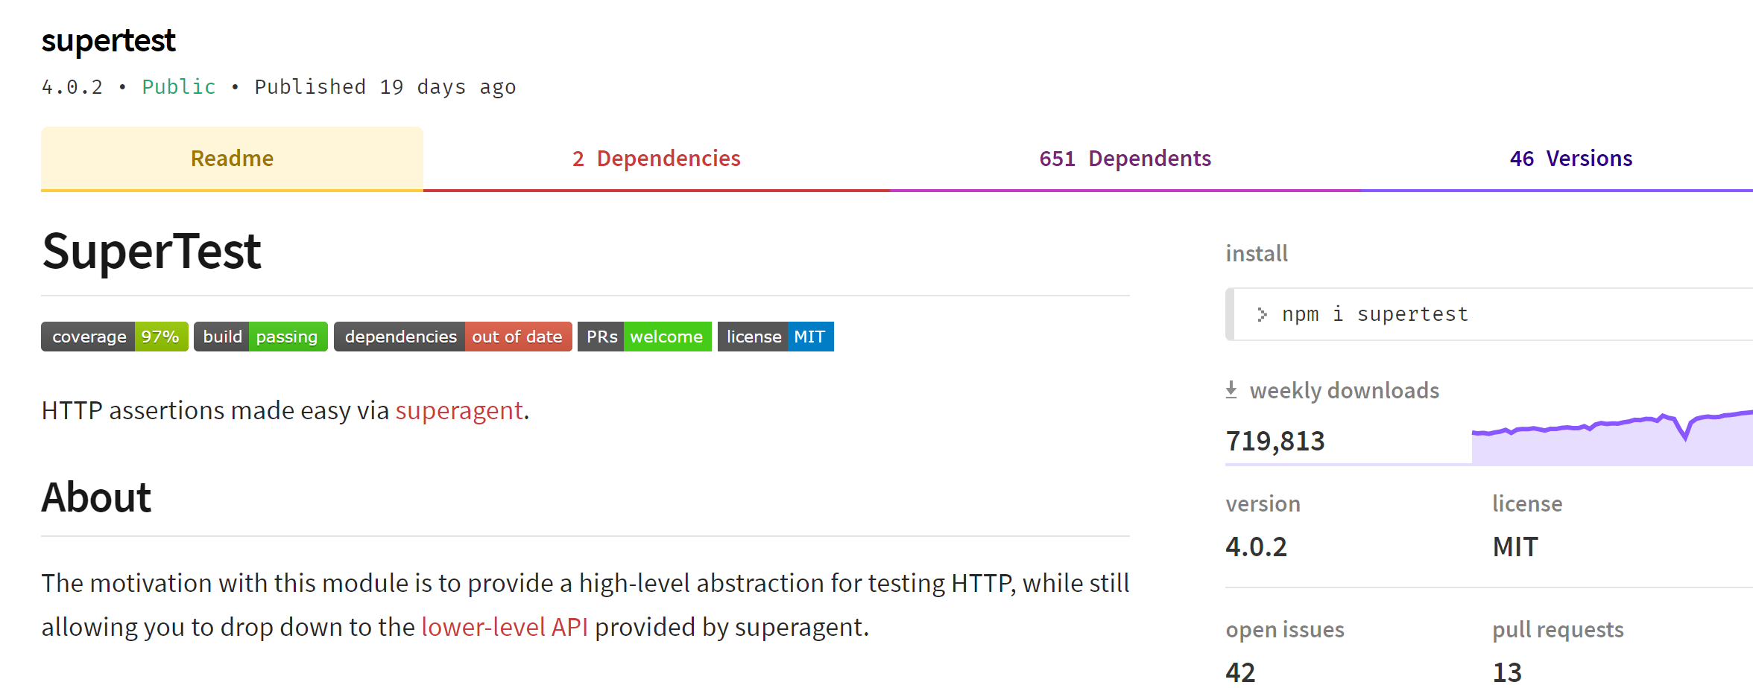
Testing Over HTTP with supertest
Provide a high-level abstraction for testing HTTP
Works with any test framework
In our case, Mocha

Slide 29
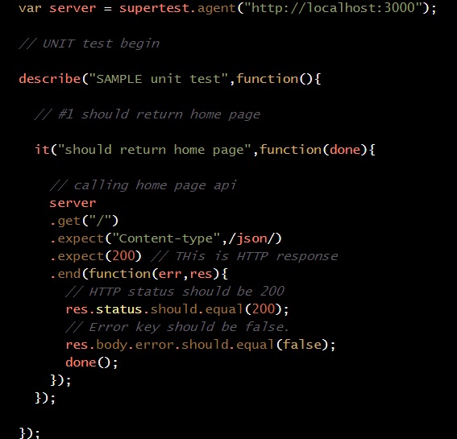
Example – Static home page test
Supertest.agent(…) returns server object constructed with test URL
“describe” takes test name and test function
“it” specifies the unit test that uses the server object to
Do a HTTP GET on the URL.
Define what’s expected (e.g. content type, status
Use “should” to check status of response object

Slide 30
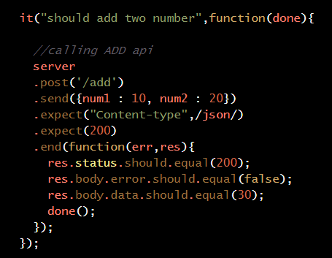
Testing a route
‘/add’ route should add two numbers provided in HTTP body
Should return json response
Data item of body should equal sum of initial numbers
“post” does a HTTP post on URL
send inserts HTTP body
Contents of reponse validated using should

Slide 31
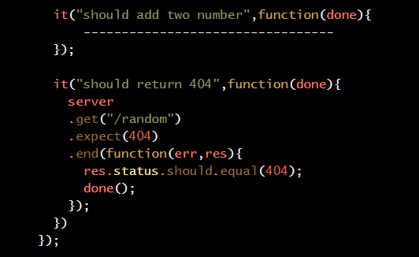
Testing failure
Can test for non-existant/removed resources
E.g. after delete
Check status of HTTP response is 404
Check status of res object is also 404

Slide 32
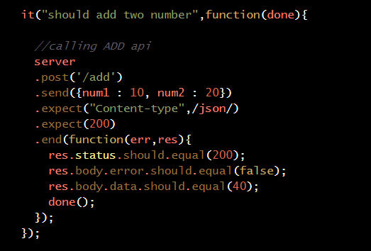
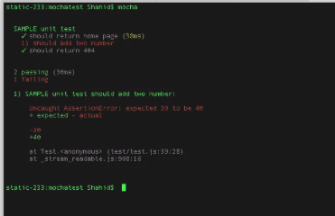
Failing Test
Equal value of addition test is changed.
40 (should be 30)
Result is test failure
Indicated clearly by test report.

Slide 33
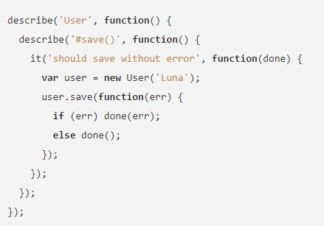
ASYNCHRONOUS CODE Test Anatomy
Uses the callback pattern.
The callback (usually named done) lets Mocha know when the test is complete
Mocha waits for this function to be called before completing the test.
“done()” called after test is complete. In this case after user.save(..) returns

Slide 34
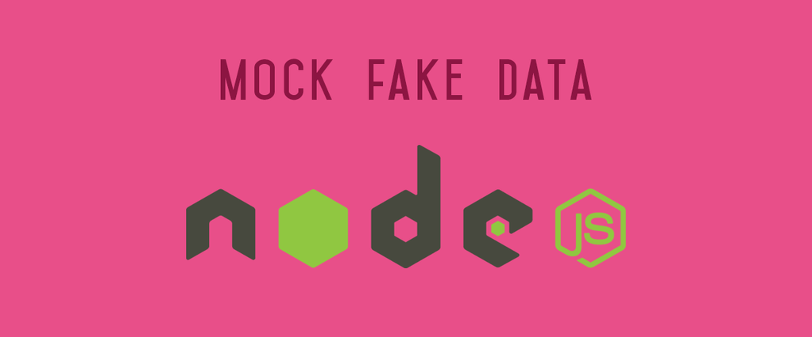
Improvements – Mocking the DB
Unit testing should only concern the unit you’re testing
Should be independent of servers/db dependencies
Tests should just test the unit in question
Unit under test may have dependencies on other (complex) units, e.g. database
To isolate the behaviour of a unit, replace dependencies by “mocks” that simulate the behaviour
DBs are impractical to incorporate into the unit test.
In short, mocking is creating objects that simulate the behaviour of real objects.

Slide 35

Mocking Mongodb
Several mocking frameworks out there
Mockery, PowerMockito
We use Mongoose
How about “Mockgoose”?!
Turns out it exists!
NPM install –save-dev Mockgoose

Slide 36
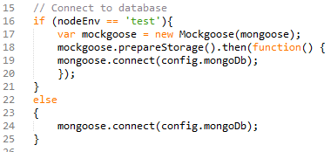
Mockgoose
Mockgoose spins up mongod when mongoose.connect call is made.
Just uses memory store with no persistence.
Can take a while on first test, after which it’s fast
Tests may time out
You can increase mocha wait time describe (…){ this.timeout(10000);

Slide 37
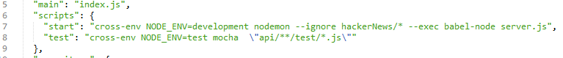
Running in test environment
Notice in the last slide we only use Mockgoose in “test” envornment
We need to set the NodeEnv environment variable as ‘test’ when we run out test script
Setting environment variables is differs across Operating Systems/platforms
Cross-Env uses a single command to set env variables without worrying about the platform
npm install save-dev cross-env
Update the test script in **package.json** to set the correct environment(s)

Slide 38
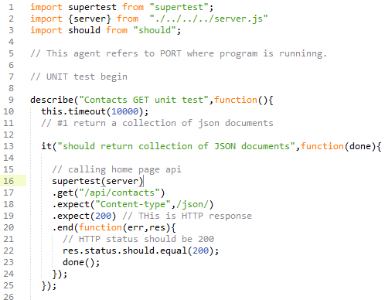
Running Server as part of Test
SuperTest allows you to create the Express API as part of the test
You can pass instance of the server to SuperTest
if the server is not already listening for connections then SuperTest will bind to a port for you so there is no need to keep track of ports.
So no need to start the server/bind to port in order to run the unit test.
Very useful for automated testing.

